Slide 1
Week 4: Summary
KUL 4.0 IIoT
Jan van Deventer

Slide 2
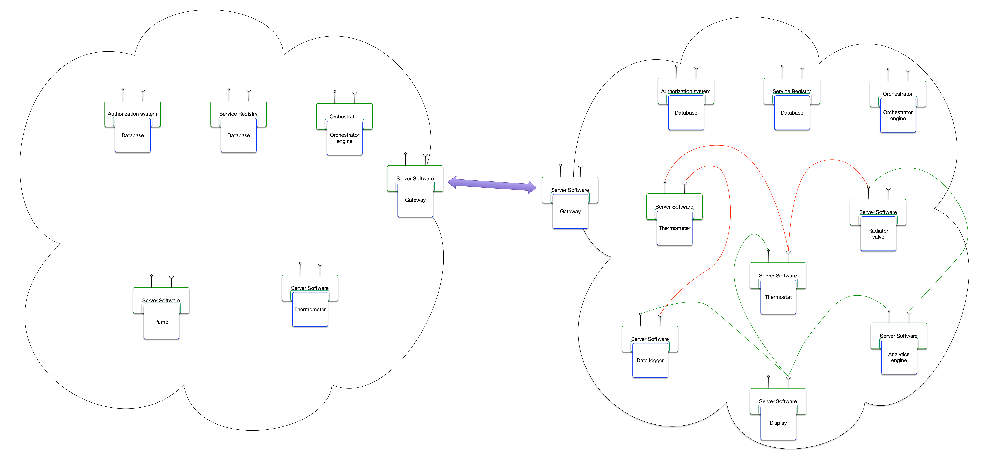
Demand response with Eclipse Arrowhead

Slide 3
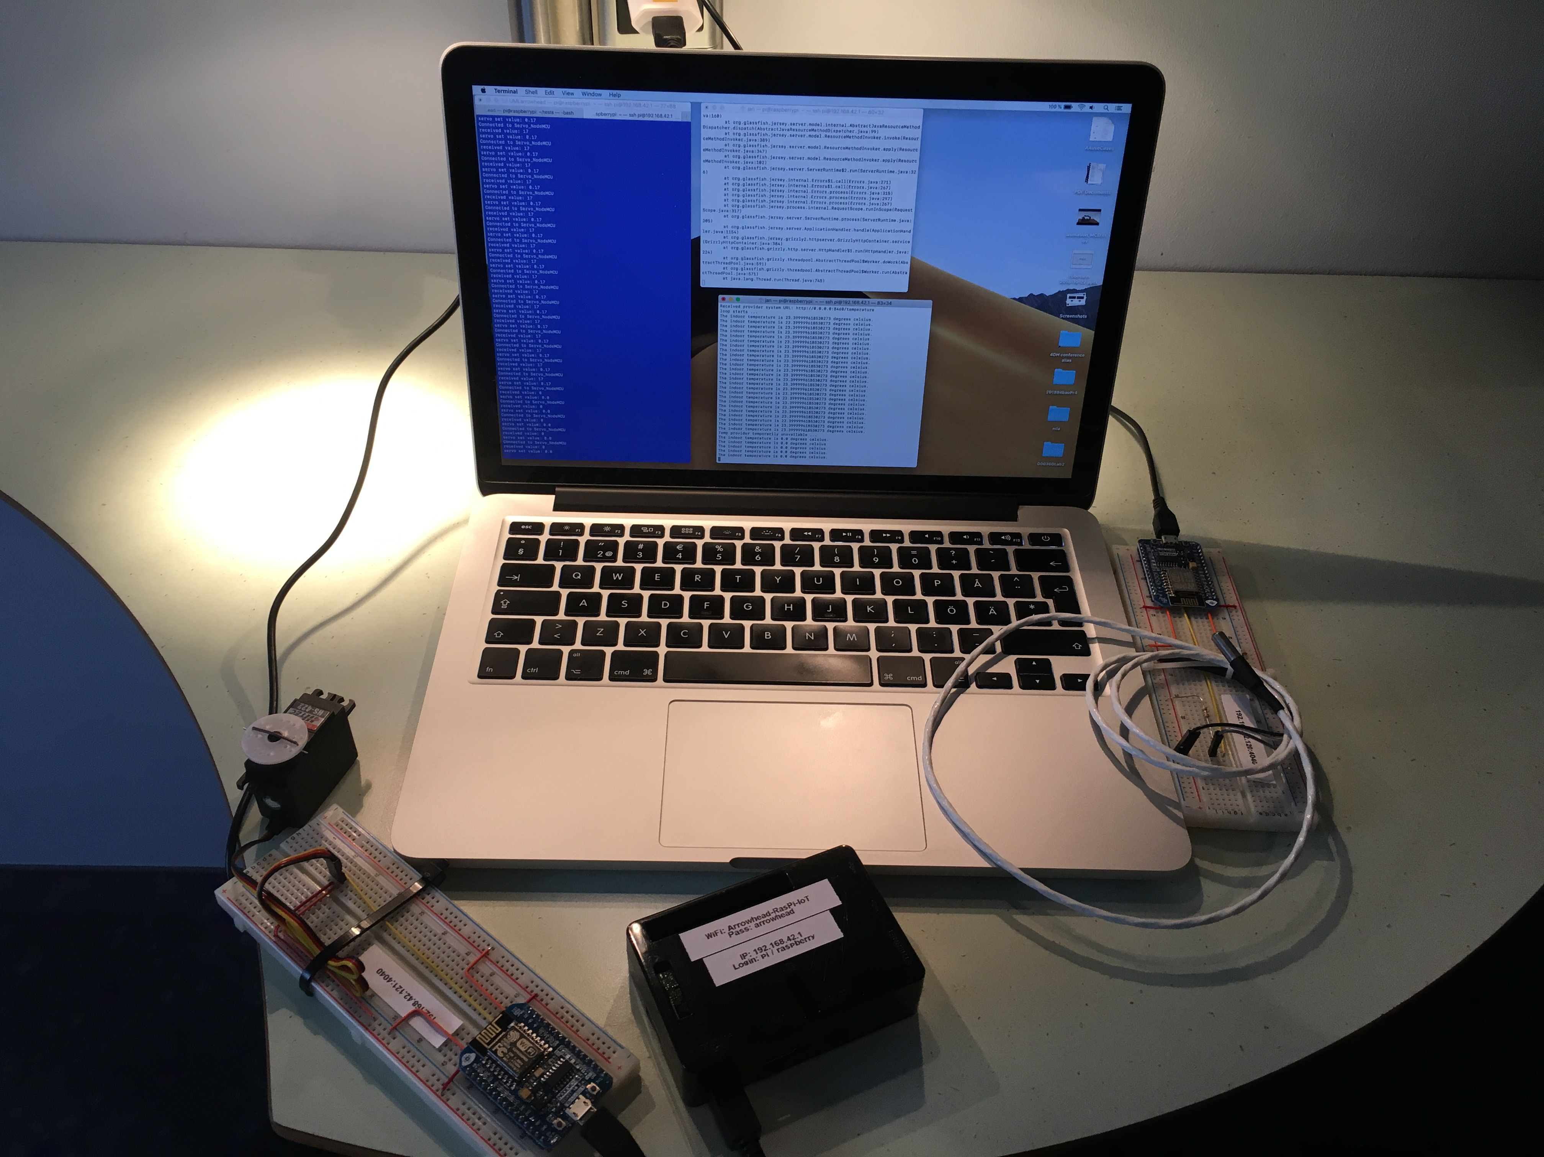
District heating substation demonstrator

Slide 4
An Industrial IoT Framework
Eclipse Arrowhead Framework
An interoperable cyber secure Service Oriented Architecture (SOA) system of systems with late binding, low latency and manageability.
There are other commercial IIoT framework and platforms with different paradigms.
You should us the one that fits your needs (now and in the long term).

